Slide 1
About SMB Enumeration
Key Features
Flowchart
Process
SMB
Enumeration

Slide 2
About SMB Enumeration:
SMB Enumeration is a method used to collect information from a system that uses the SMB (Server Message Block) protocol. SMB is mostly used in Windows systems for sharing files, folders and printers across a network. By running an SMB enumeration scan you can find out what resources are being shared and get useful details like usernames, groups and even the system's OS info.
This is a really useful step in penetration testing because it can reveal misconfigurations or open shares that an attacker might take advantage of.
Standards

Slide 3
Key Features
• List Shared Resources:
Shows folders, printers and drives shared over the network.
• User and Group Info:
Lists usernames and group names from the system.
• OS and Host Details:
Gives info like the hostname and operating system.
• Detect Vulnerabilities:
Helps identify if there are any security issues with SMB.
• Access Control Testing:
Lets you see if shared files are protected properly.

Slide 4
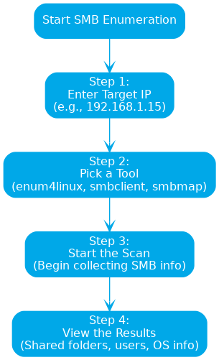
Flowchart

Slide 5
Process
Step 1: Enter the Target IP Address • Input the IP address of the system you want to scan for SMB data.
Example: 192.168.1.15 Step 2: Choose the Tool or Method • Select the enumeration tool or technique you want to use, such as:
- smbclient
- enum4linux
- smbmap
- nbtscan
Step 3: Start the Enumeration • Click Start to begin scanning the target system for SMB-related information.
Step 4: View the Output • The results will show available shares, user accounts, OS version and any other accessible information.
Click on the model to interact

Slide 6
2. Relation between Earth, Sun, and Moon
Let's look at an example:
• enum4linux -a 192.168.1.15
Now lets breakdown the command:-
• -a: Runs all enumeration options available.
• 192.168.1.15: Target IP address to scan.
• 192.168.1.1: The gateway or router being spoofed.
Another example with smbclient:
• smbclient -L //192.168.1.15 -N
Now lets breakdown the command:-
• -L: Lists the shares
• -N: Tells it to connect without asking for a password

